Slide 1

R A C H E L ,
K A J A L ,
A N D J A I
ZIPRECRUITER USABILITY
TEST
UX Research Final Project

Slide 2

R E S E A R C H G O A L
G O A L
Answer Usability Quesions:
Is this application solving the problems it intended to solve?
Is this application usable by its intended audience?

Slide 3



H I G H
L E V E L
H I G H L E V E L F I N D I N G S
Participants felt confused by on-boarding process. Job search lead to distrust of options for first time participants
Participants were missing important information from the search page

Slide 4

METHOD

Slide 5

M E T H O D O L O G Y
S I X
P A R T I C I P A N T S
currently looking for work ages 20-28
M O D E R A T E D C O F F E E - S H O P S E S S I O N S
randomly selected

Slide 6
TASKS
And what we found

Slide 7
A L L T A S K S
O N B O A R D I N G
S E A R C H F O R A J O B
A P P L Y F O R A J O B
S A V E J O B F O R L A T E R
C U S T O M I Z E A L E R T S
O P E N F O R E M P L O Y E R

Slide 8
T A S K S
W I T H P A I N P O I N T S
O N B O A R D I N G
S E A R C H F O R A J O B
A P P L Y
F O R A J O B
S A V E J O B F O R L A T E R
C U S T O M I Z E A L E R T S
O P E N F O R E M P L O Y E R

Slide 9
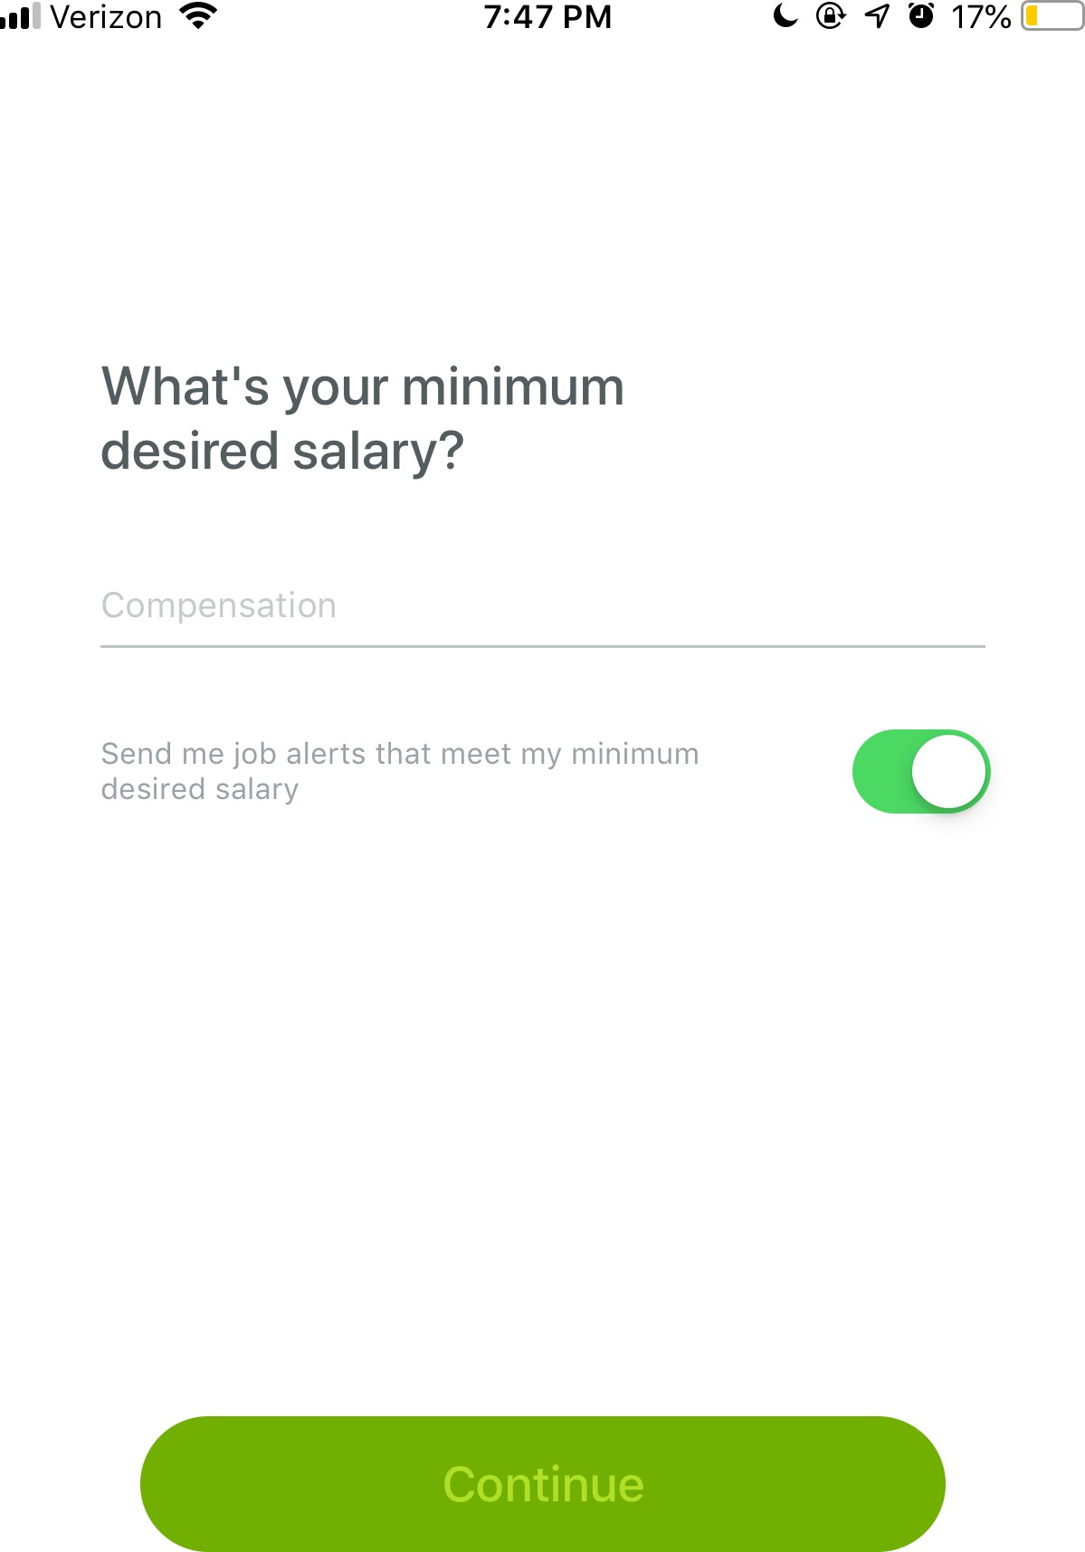
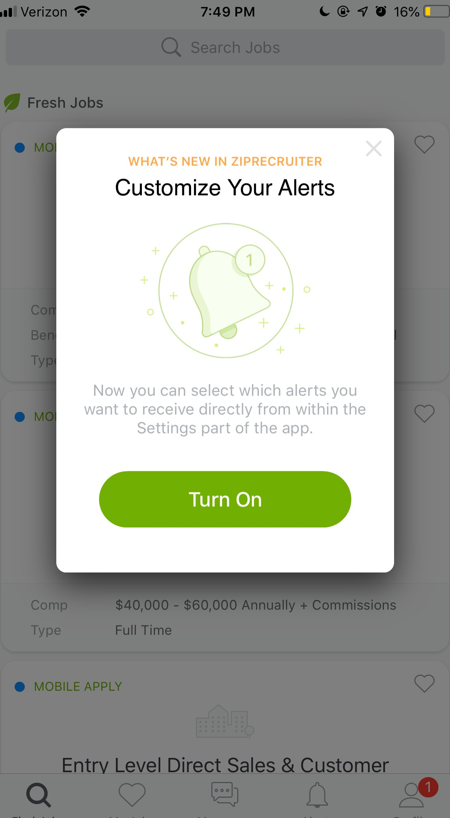
UNEXPECTED PATH
O N B O A R D I N G
Participants who haven't worked before were unsure of what to enter for desired income.
Participants were uncomfortable making an account without being able to see what the app has to offer.

Slide 10
O N B O A R D I N G
"I HAVE NO IDEA WHAT NOTIFICATIONS I EVEN NEED. WHY IS THIS ASKING ME NOW?"
-Stephanie

Slide 11

TIMIING
R O O M
F O R G R O W T H

Slide 12
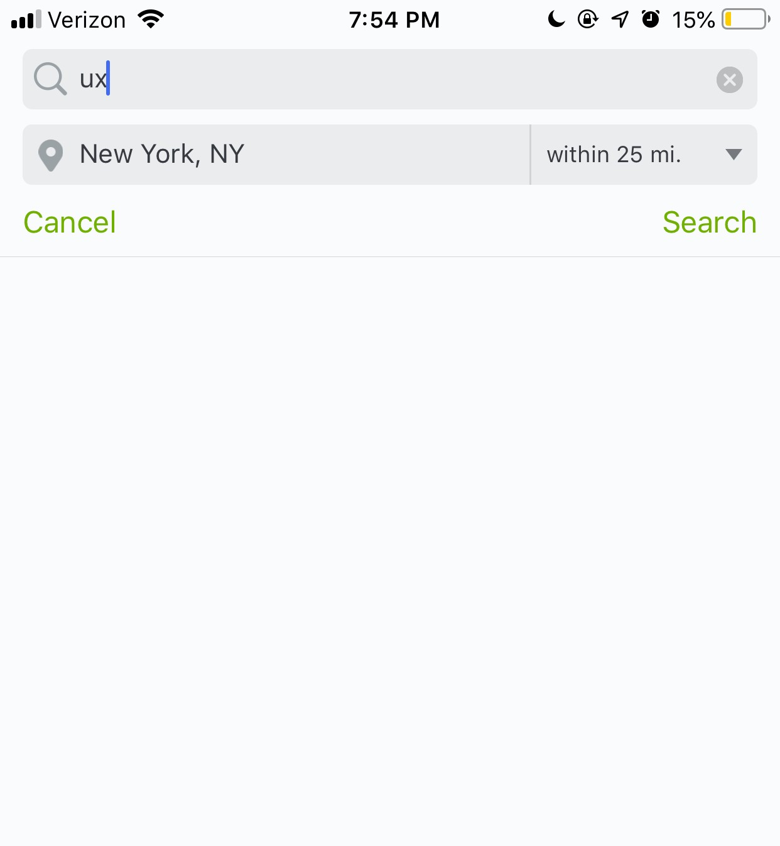
L O C A T I O N I S S U E S
S E A R C H
F O R J O B
Some participants were unsure how to add their desired work location because they expected to do it before starting a search

Slide 13
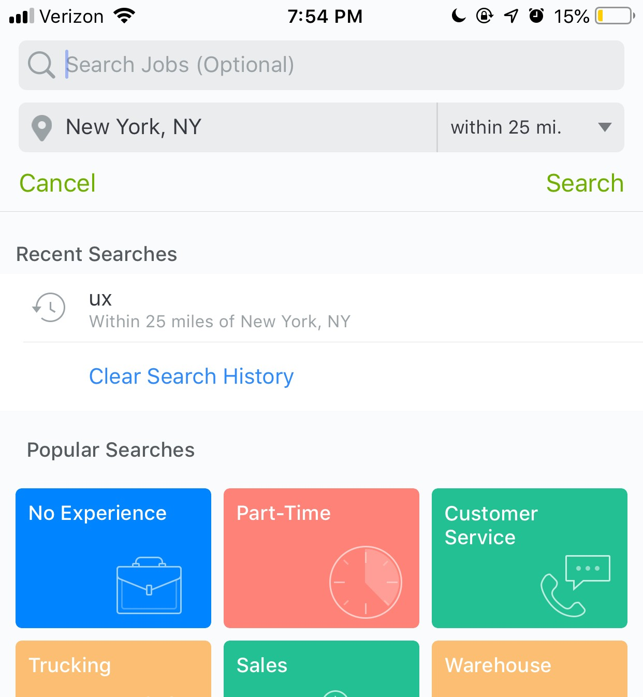
N E E D E D M O R E F I L T E R I N G
S E A R C H
F O R J O B
Participants were confused when they could only elect three types of information to start a search
Some thought colored boxes were able to add a kind of filter or sort to their search.

Slide 14
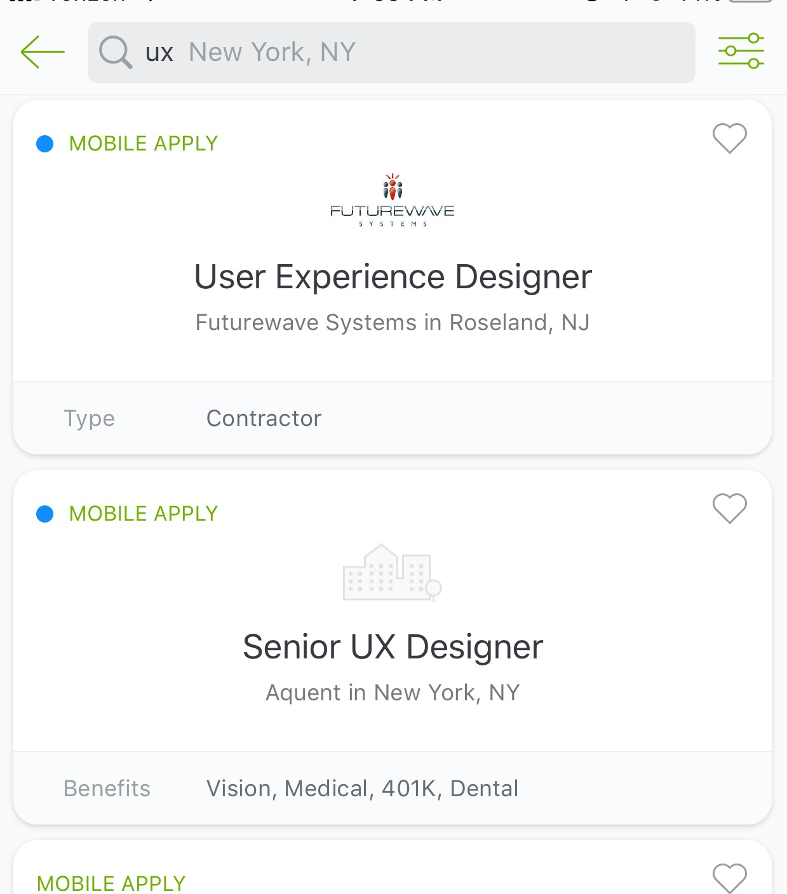
M I S S I N G
S E A R C H
F O R J O B
I N F O R M A T I O N
Participants felt that they didn't have the information they needed on the search page to select a job to apply to.

Slide 15

O P T I O N S S E E M E D
S E A R C H
F O R J O B
I L L E G I T I M A T E
Some search results came back with generic names like "software company" rather than a company name.

Slide 16
S E A R C H
F O R J O B
"JUST BEING NEW TO THIS, MY OPTIONS SEEM A LITTLE BIT...SHADY?"
Christian

Slide 17

INFORM EARLIER
R O O M
F O R G R O W T H

Slide 18
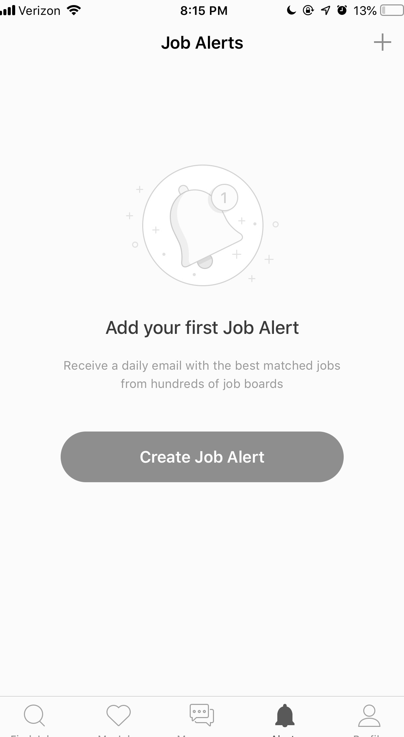
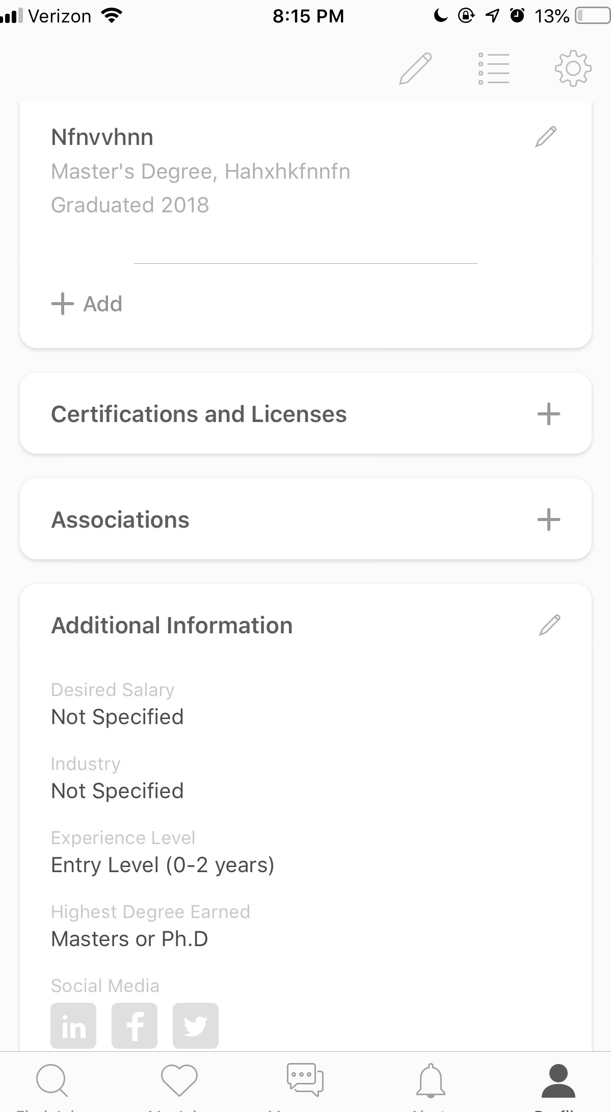
C U S T O M I Z E
A L E R T S
F O U N D
O P T I O N S W E R E N ' T W H E R E
F O U N D
E X P E C T E D
Since the bell is a recognizable icon for notifications, this is where participants went even for push notifications.
Participants were still frustrated with the experience, even though they were able to remedy the location issue.
E X P E C T E D

Slide 19

CONSITANCY
R O O M
F O R G R O W T H

Slide 20

O P T I O N N O T F O U N D ,
O P E N
F O R E M P L O Y E R
B U T W O U L D B E A P P R E C I A T E D
Since this option seems to be a standard on most job search platform - we decided to ask users to see if they could find the option since we couldn't find it ourselves.
Participants were expecting this option to be automatic

Slide 21

THANK
YOU
R A C H E L ,
K A J A L , J A I
We're open to any questions
at this time

